Slide 1
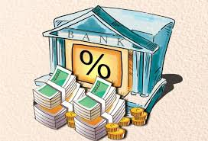
Banking

Slide 2

Meaning of Banking
Banking is an industry that handles cash, credit, and other financial transactions. Banks provide a safe place to store extra cash and credit.

Slide 3
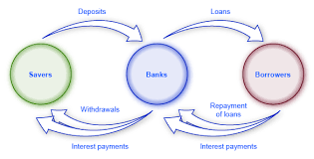
Definition of Banking
As per Section 5(b) of the Banking Regulation Act, 1949 , "banking" means the accepting, for the purpose of lending or investment, of deposits of money from the public, repayable on demand or otherwise, and withdrawable by cheque, draft, order or otherwise.

Slide 4

History of Bank
Bank of England (Issue of Banknotes) - 1695
Royal Bank of Scotland ( Overdraft) – 1728
The word bank was borrowed in Middle English and from Middle French ”banque”, from Old Italian ”banco”, meaning "table", from Old High German banc, bank "bench, counter".

Slide 5
Evolution of Banking in India
Bank of Hindustan - 1770 and liquidated in 1829–32
General Bank of India - 1786 but failed in 1791
The largest bank, and the oldest still in existence, is the State Bank of India (S.B.I)
Reserve Bank of India was established in 1935, under the Reserve Bank of India Act, 1934.

Slide 6
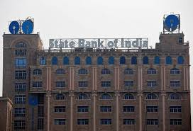
State Bank of India
It was originated and started working as the Bank of Calcutta in mid-June 1806.
In 1809, it was renamed as the Bank of Bengal.
The other two were the Bank of Bombay in 1840 and the Bank of Madras in 1843.
The three banks were merged in 1921 to form the Imperial Bank of India, which upon India's independence, became the State Bank of India in 1955.

Slide 7
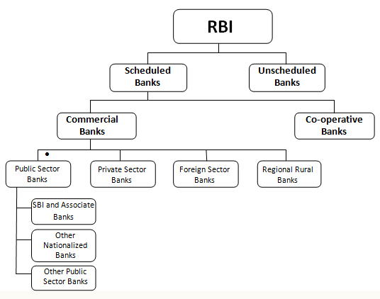
Structure of Indian Banking System

Slide 8
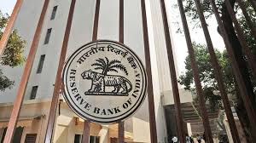
Reserve Bank of India
Reserve Bank of India (RBI) is India's central banking institution, which controls the monetary policy of the Indian rupee. It commenced its operations on 1 April 1935 in accordance with the Reserve Bank of India Act, 1934.
Headquarters – Mumbai
Present Governor – Urjit Patel

Slide 9
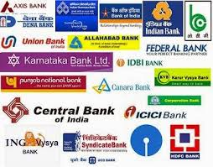
Scheduled Commercial Banks
Scheduled commercial banks are those banks which are included in the Schedule II of RBI Act, 1934. Scheduled commercial banks carry out the normal business of banking activities such as accepting deposits, giving loans and other banking services.

Slide 10
Non-Scheduled Banks
Non-scheduled banks are the banks that do not adhere to the norms prescribed by the Reserve Bank of India (RBI).
Andaman and Nicobar State Co-operative Bank Ltd. 2 Arunachal State Co-operative Apex Bank Ltd. 3 Assam Co-operative Apex Bank Ltd. 4 Chandigarh State Co-operative Bank Ltd. 5 Delhi State Cooperative Bank Ltd. 6 Jammu and Kashmir State Co-operative Bank Ltd. 7 Jharkhand State Cooperative Bank Ltd. 8 Manipur State Co-operative Bank Ltd. 9 Meghalaya Co-operative Apex Bank Ltd. 10 Mizoram Co-operative Apex Bank Ltd. 11 Nagaland State Co-operative Bank Ltd. 12 Sikkim State Co-operative Bank Ltd. 13 Tripura State Co-operative Bank Ltd.

